Slide 1

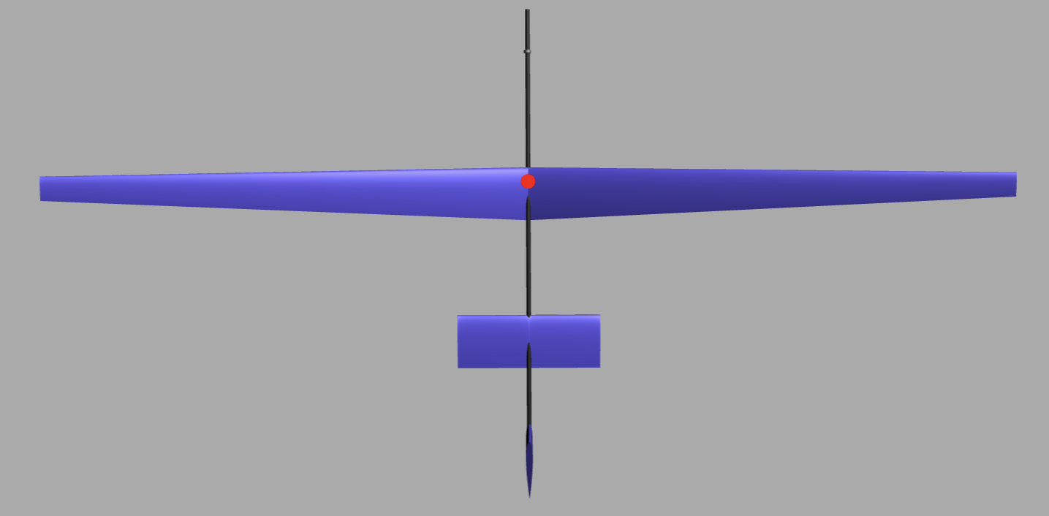
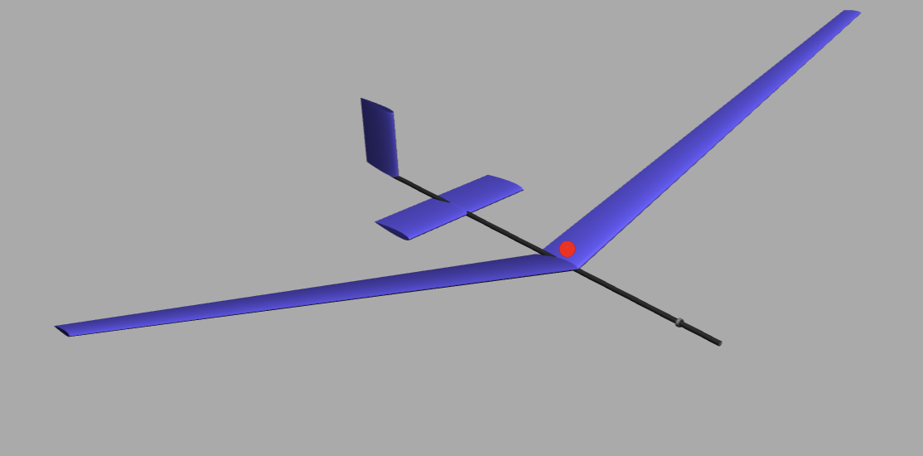
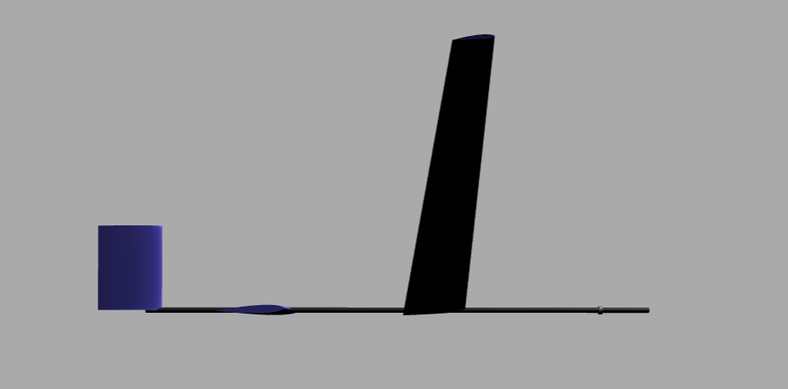
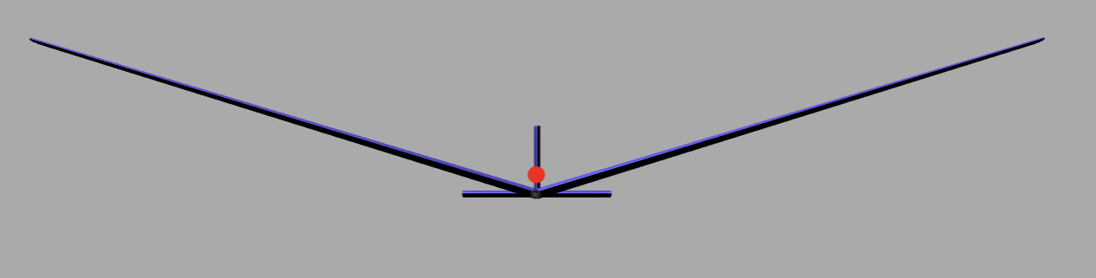
V Stab. : NACA 0012
Mount: 0.0 deg
Dihedral: 0.0 deg
Sweep: 0.0 deg
Twist: 0.0 deg
Xloc: -3.6 ft
CG:
Xloc: - 0.0231 ft
Yloc: 0.0 ft
Zloc: - 0.2287 ft
H. Stab. : NACA 0012
Mount: 2.357 deg
Dihedral: 0.0 deg
Sweep: 0.0 deg
Twist: 0.0 deg
Xloc: -2.0734 ft
Main Wing: NACA 2412
Span: 12.5’
Root Chord: 0.75’
RA = 0.4
SW: 6.5625 sq. ft
H. Stab: NACA 0012
Span: 2 ft
Root Chord: 0.75 ft
SW: 1.5 sq. ft
Main Wing: NACA 2412
Mount: 6.546 deg
Dihedral: 17.0 deg
Sweep: 0.0 deg
Twist: 0.0 deg
Xloc: 0 ft
V. Stab: NACA 0012
Span: 1 ft
Root Chord: 0.75 ft
SW: 0.75 sq. ft
Fuselage:
Length: 6ft
Xloc: -0.6 ft
Ballast:
Height: 0.0417
Out Rad: 0.05 ft
In Rad: 0.03125 ft
Xloc: 1.8117 ft
Yloc, Zloc: 0 ft

